Slide 1
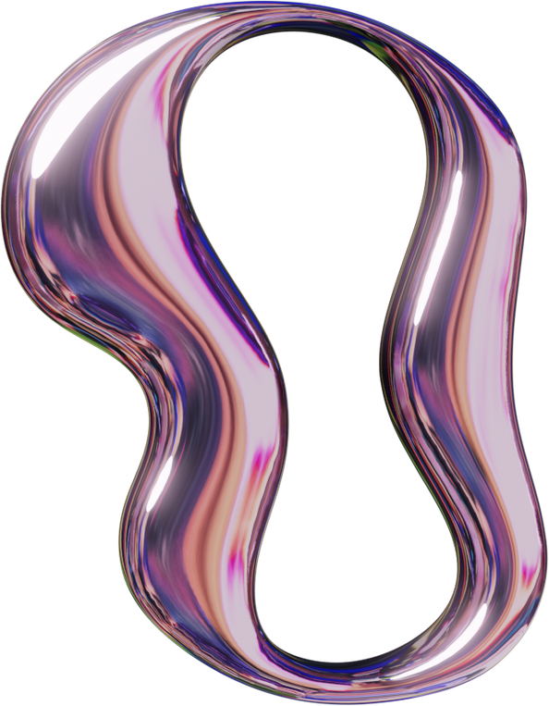


DATA PROCESSING PIPELINE WITH AZURE DATA FACTORY
Serverless data processing with Azure Data Factory & Databricks
page 01
2025

Slide 2



Table of Contents
Project Statement
Project Overview
Prerequisites
Azure Resources Used
Project Objectives
Tools and Technologies
Execution Overview
Implementation – Tasks Performed
Practical Implementation on Azure Portal
Successful Output Generated
Strategies for Serverless Data Processing
Conclusion
page 02

Slide 3
Project Statement
The goal of this project is to design and implement a serverless data processing pipeline.
Azure Data Factory serves as the orchestration tool, managing the flow of data from ingestion to reporting.
Azure Databricks is used as a serverless Spark processing engine, performing on-demand analytics and transformations without the need for managing infrastructure.
This approach ensures scalability, reduced operational overhead, and cost efficiency.
page 03

Slide 4
Project Overview
The project focuses on a healthcare analytics scenario where multiple data sources are integrated and transformed to produce actionable insights.
The pipeline processes patient details, doctor information, appointments, billing records, and medical procedures.
The data follows a multi-layered journey: from raw ingestion, through processing and transformation, and finally into analytical storage for reporting.
By combining Azure Data Factory and Databricks, the system delivers insights into patient behavior, doctor performance, and healthcare operations.
page 04

Slide 5
Prerequisites
Before starting the project, certain requirements had to be met:
An active Azure Subscription to host all resources.
A Data Factory instance for pipeline creation.
A Databricks workspace and cluster for Spark-based processing.
An Azure Storage Account with containers for raw, processed, and transformed data.
Access keys and permission setup to allow ADF and Databricks to communicate securely.
Installation of required libraries and dependencies.
Proper monitoring and logging configuration for transparency and troubleshooting.
page 05

Slide 6
Azure Resources
Used
The implementation relied on the following Azure resources:
Azure Blob Storage – For raw and processed datasets.
Azure Storage Account – As the base storage layer.
page 06
Azure Data Factory – For pipeline orchestration.
Databricks Notebook Activity – To run transformations and analysis.
Azure Delta Tables – For efficient querying and optimized storage.

Slide 7
Project Objectives
This project was designed to achieve the following objectives:
Automate data pipelines for healthcare records using Azure Data Factory.
Convert raw CSV healthcare data into optimized Parquet format.
Build a multi-layered architecture: Raw → Processed → Analyzed.
Implement data quality checks and standard transformations.
Generate actionable insights through advanced analytics.
Improve performance with partitioning and compression.
Ensure pipelines are documented, reusable, and easy to maintain.
page 07

Slide 8

Tools and Technologies
AZURE DATA FACTORY
– central orchestrator for workflows.
AZURE DATABRICKS
– transformation engine.
AZURE BLOB STORAGE
– storage for all layers of data.
page 08
DELTA LAKE
– enabled faster queries and reliability.
PYSPARK LIBRARIES
– for data transformation and validation.
SQL ANALYTICS
– to perform reporting and analysis queries.

Slide 9
Execution
Overview
The execution followed a structured approach:
Data Storage: Raw CSVs were uploaded into Blob Storage. Processed Parquet files and transformed datasets were stored in separate containers.
Orchestration (ADF): Three pipelines were created—Ingestion, Transformation, and Analysis. These were later combined into a master pipeline for end-to-end automation.
Processing (Databricks): Separate notebooks handled ingestion, cleaning, transformations, and analysis. Business logic was applied to generate meaningful metrics.
Monitoring: ADF and Databricks dashboards were used to track execution performance and errors.
page 09

Slide 10
Implementation:
Tasks Performed
Key implementation steps included:
Designing the multi-layer storage architecture with raw, source, and destination containers.
Setting up pipelines in ADF for ingestion, transformation, and analysis.
Creating Databricks notebooks for each stage of data processing.
Configuring linked services for secure communication between services.
Managing execution dependencies to ensure a smooth pipeline flow.
Applying performance optimizations and enabling monitoring.
page 10

Slide 11
Practical Implementation
Azure Portal
Databricks Setup: Created a workspace and Spark cluster.
Storage Account: Configured raw, source, and destination containers.
Data Upload: Loaded CSV files into the raw container.
Notebooks: Developed ingestion notebooks (patients, doctors, billing, procedures, appointments), transformation notebooks, and analysis notebooks.
ADF Setup: Built pipelines and defined linked services for Blob Storage and Databricks.
Master Pipeline: Combined all individual pipelines using Execute Pipeline activity.
Trigger & Monitor: Pipelines were triggered and monitored via ADF’s run history.
page 11

Slide 12
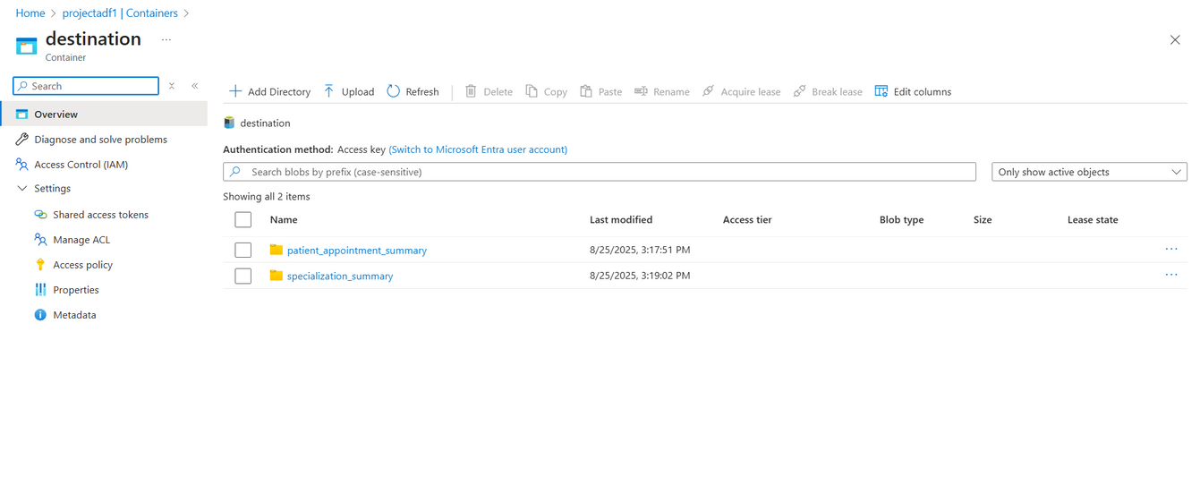
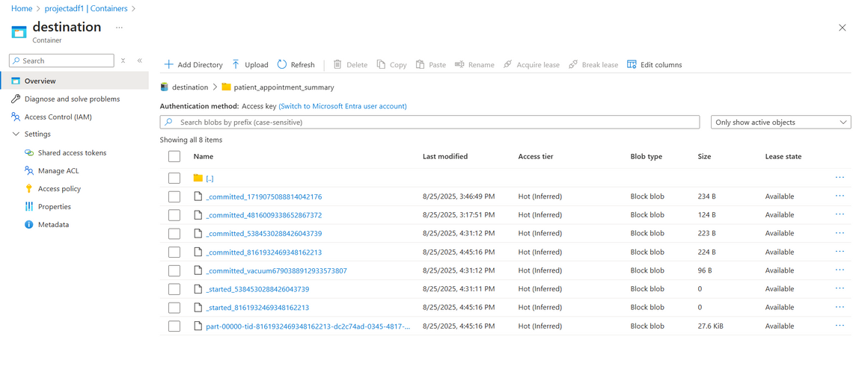
Successful
Output Generated
All pipelines ran successfully, storing raw data in the Source container and transformed data in the Destination container.
page 12

Slide 13
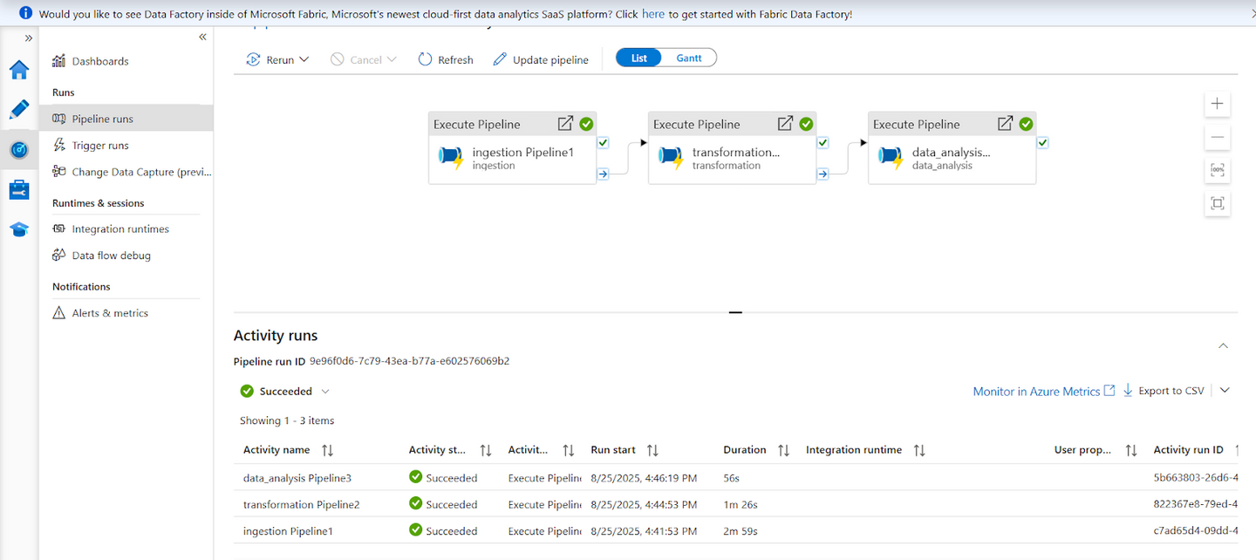
Successful
Output Generated
page 12

Slide 14
Strategies for Serverless Data Processing
To make the pipeline scalable and cost-efficient, the following strategies were applied:
Leveraging serverless/on-demand compute with auto-terminating Databricks clusters.
Separating storage from compute, using Blob + Delta Lake for reliability.
Designing modular pipelines for ingestion, transformation, and analysis.
Optimizing data with partitioning, Z-ordering, and compression.
Enforcing security & governance using Managed Identity and Unity Catalog.
Monitoring with Azure Monitor and Log Analytics.
Using CI/CD integration for deployment automation.
Implementing error handling and retries to make pipelines more resilient.
page 13

Slide 15
Conclusion
The project successfully demonstrated how Azure Data Factory and Azure Databricks can be combined to build a serverless, end-to-end data pipeline.
ADF ensured smooth orchestration and dependency management.
Databricks provided the computational power for large-scale transformations and analytics.
Delta Lake guaranteed consistency and performance for querying.
Monitoring dashboards offered visibility into pipeline health and execution.
The outcome is a scalable, cost-optimized, and maintainable pipeline that empowers healthcare organizations to make data-driven decisions effectively.
page 14

Slide 16
THANK YOU!
page 15

